Slide 1
Capstone Project-4
NETFLIX MOVIES AND TV SHOWS CLUSTERING
Sandeep Kumar Maurya
Ansh Bhatnagar

Slide 2

Netflix and chill !
Problem Statement
EDA
Data Pre-processing
Topic modelling
Recommendation system
K- Means Clustering
Cluster Analysis

Slide 3
Too many choices
This dataset consists of tv shows and movies available on Netflix as of 2019. The dataset is collected from Flixable which is a third-party Netflix search engine.
In 2018, they released an interesting report which shows that the number of TV shows on Netflix has nearly tripled since 2010. The streaming service’s number of movies has decreased by more than 2,000 titles since 2010, while its number of TV shows has nearly tripled. It will be interesting to explore what all other insights can be obtained from the same dataset.

Slide 4
Data Summary
Show_id : Unique ID For Every Movie / Tv Show
Director : Director Of The Movie
Type : Identifier - A Movie Or TV Show
Title : Title Of The Movie / Tv Show
Cast : Actors Involved In The Movie / Show
Country : Country Where The Movie / Show Was Produced
Date Added : Date It Was Added On Netflix
Release Year : Actual Release Year Of The Movie / Show
Rating : TV Rating Of The Movie / Show
Duration : Total Duration - In Minutes Or Number Of Seasons
Listed_in : Genere
Description: The Summary Description

Slide 5
Null Values
Delete if more than 8% (cast and Director)
Delete rows with missing date (<0.5%)
Fill categoricals with frequent values

Slide 6
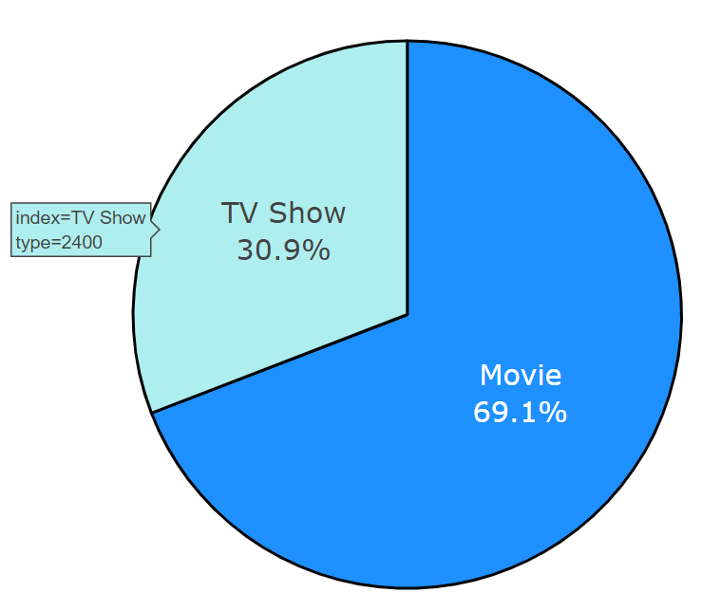
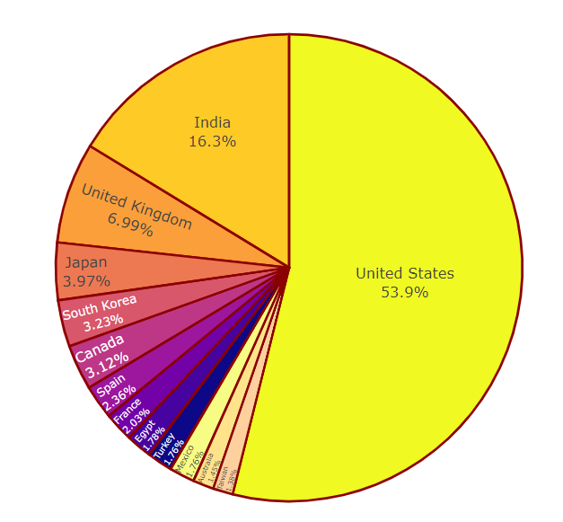
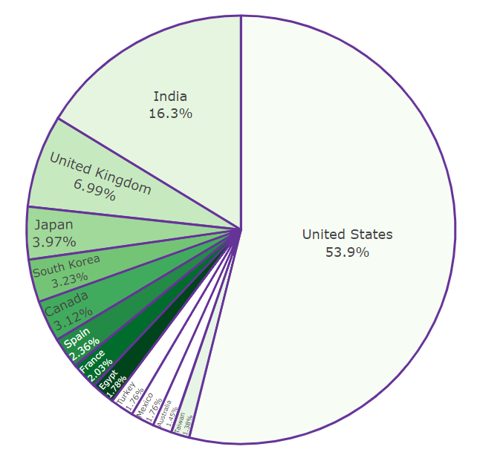
EDA
index=Movie
type=5377

Slide 7
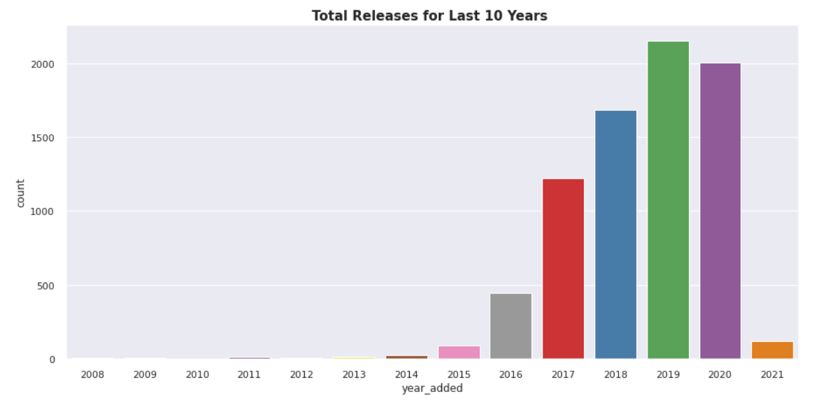
EDA

Slide 8
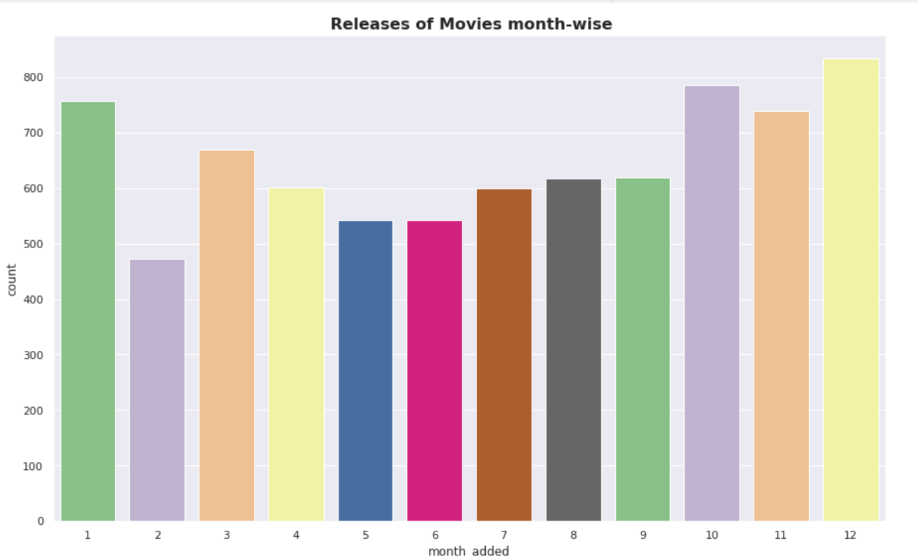

Slide 9
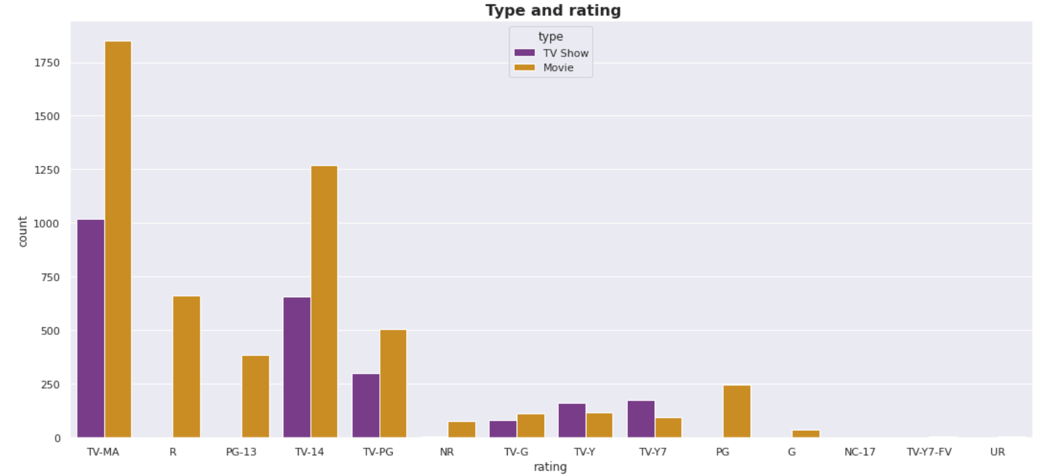

Slide 10
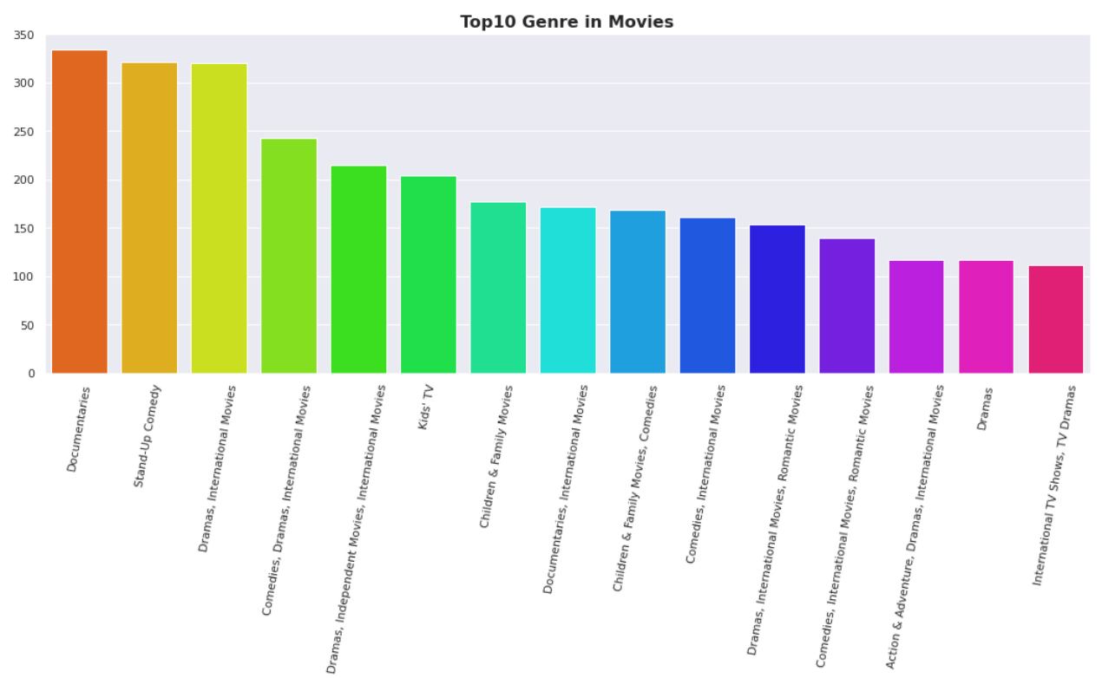

Slide 11
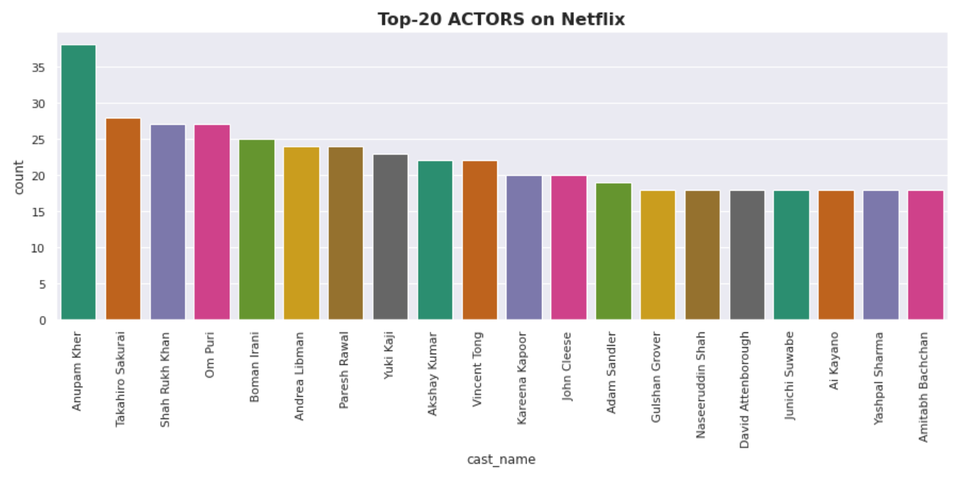

Slide 12
Data Cleaning
Label Encoding-Label Encoding refers to converting the labels into a numeric form so as to convert them into the machine-readable form. Machine learning algorithms can then decide in a better way how those labels must be operated. It is an important pre-processing step for the structured dataset in supervised learning.
Lemmatisation- Lemmatization, unlike Stemming, reduces the inflected words properly ensuring that the root word belongs to the language. In Lemmatization root word is called Lemma. ... For example, runs, running, ran are all forms of the word run, therefore run is the lemma of all these words.
Removing Stop words - To remove stop words from a sentence, you can divide your text into words and then remove the word if it exits in the list of stop words provided by NLTK.
Tf - idf Vectorization - TF-IDF stands for “Term Frequency — Inverse Document Frequency”.
This is a technique to quantify a word in documents, we generally compute a weight to each word which signifies the importance of the word in the document and corpus. This method is a widely used technique in Information Retrieval and Text Mining.
Min-max Scaling - For each value in a feature, MinMaxScaler subtracts the minimum value in
the feature and then divides by the range. It preserves shape of original distribution.

Slide 13
Topic Modelling (LDA and LSA)
Latent Semantic Analysis(LSA) is used to find the hidden topics represented by the document or text. This hidden topics then are used for clustering the similar documents together. LSA is an unsupervised algorithm and hence we don't know the actual topic of the document.
●In natural language processing, the Latent Dirichlet Allocation (LDA) is a generative statistical model that allows sets of observations to be explained by unobserved groups that explain why some parts of the data are similar.

Slide 14
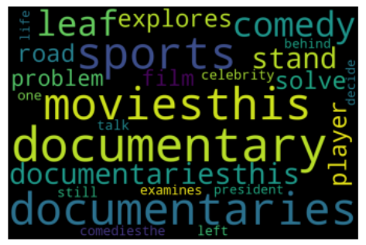
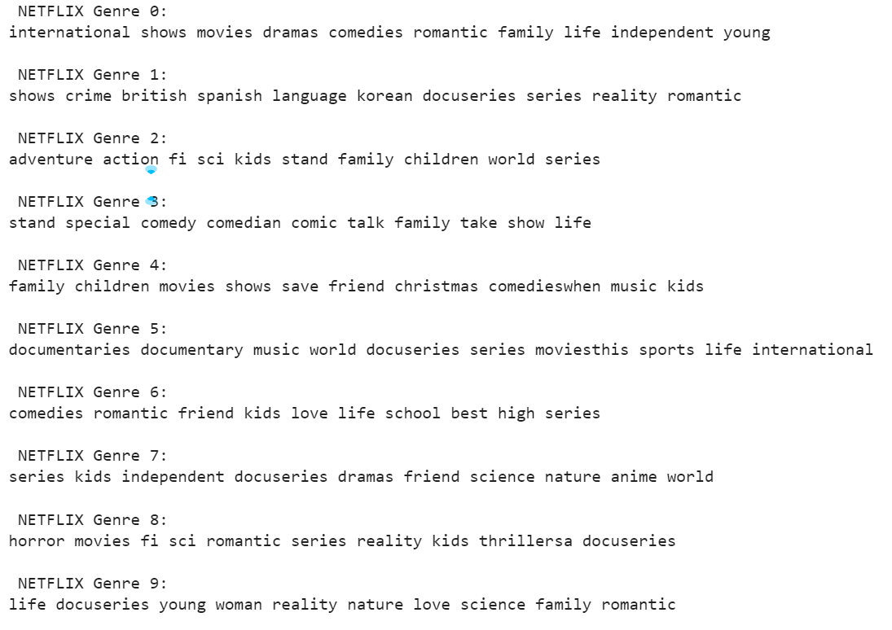
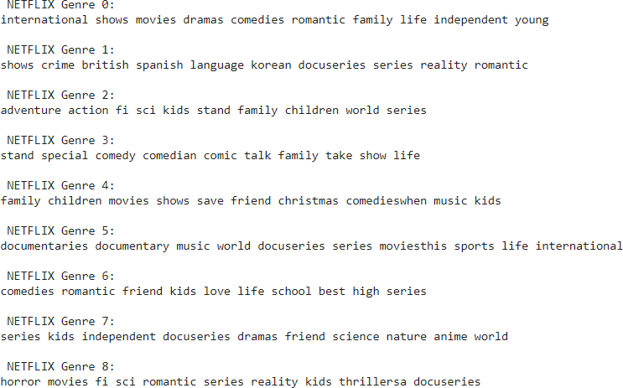
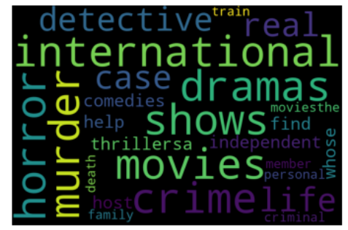
Topic Modelling (LDA and LSA)

Slide 15
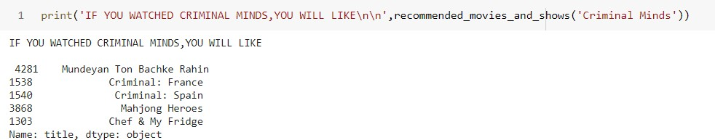
Recommendation
A recommender system, or a recommendation system (sometimes replacing 'system' with a synonym such as platform or engine), is a subclass of information filtering system that seeks to predict the "rating" or "preference" a user would give to an item.

Slide 16
K - Means
To process the learning data, the K-means algorithm in data mining starts with a first group of randomly selected centroids, which are used as the beginning points for every cluster, and then performs iterative (repetitive) calculations to optimize the positions of the centroids
It halts creating and optimizing clusters when either:
The centroids have stabilized — there is no change in their values because the clustering has been successful.
The defined number of iterations has been achieved

Slide 17
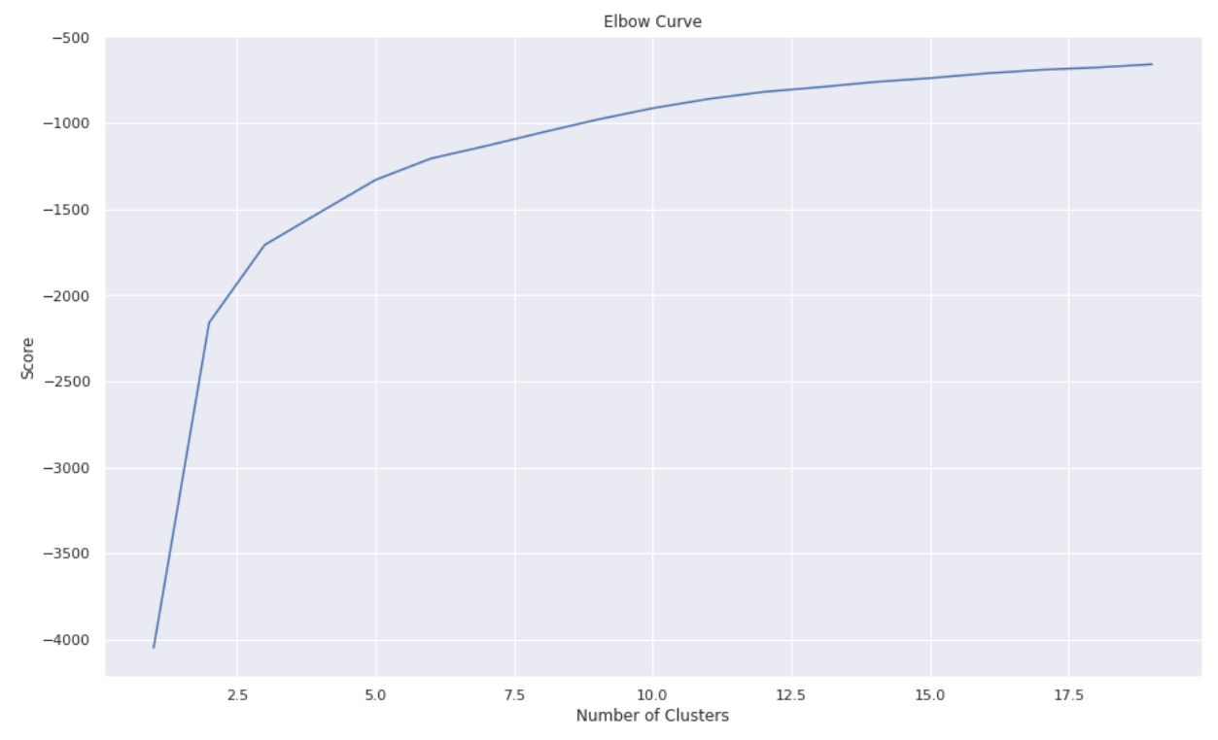
K-Means

Slide 18
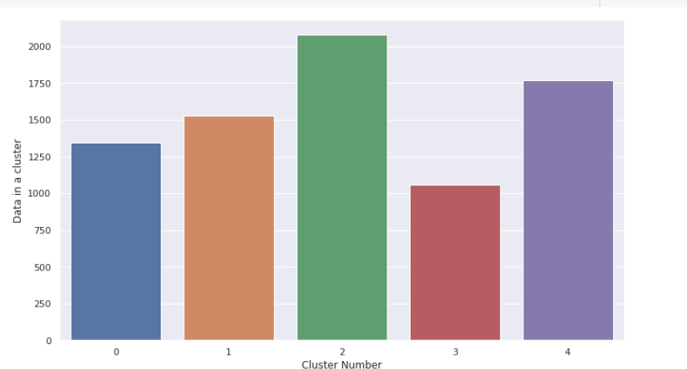
Clusters

Slide 19
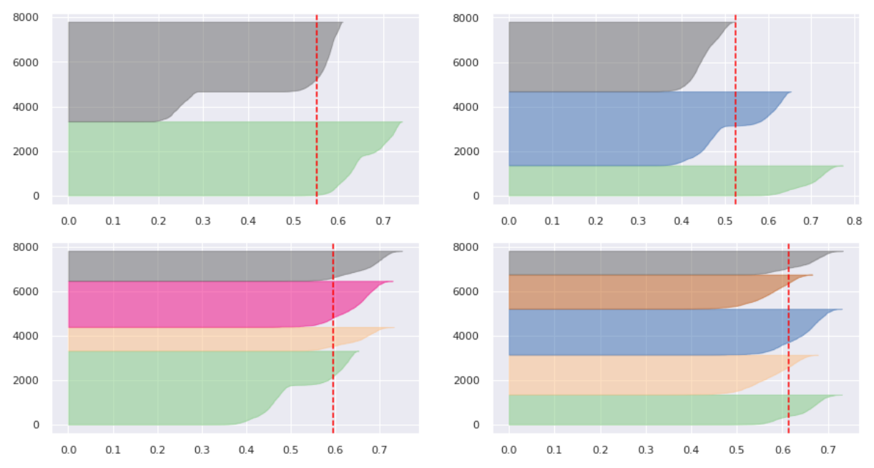
Silhouette Analysis

Slide 20
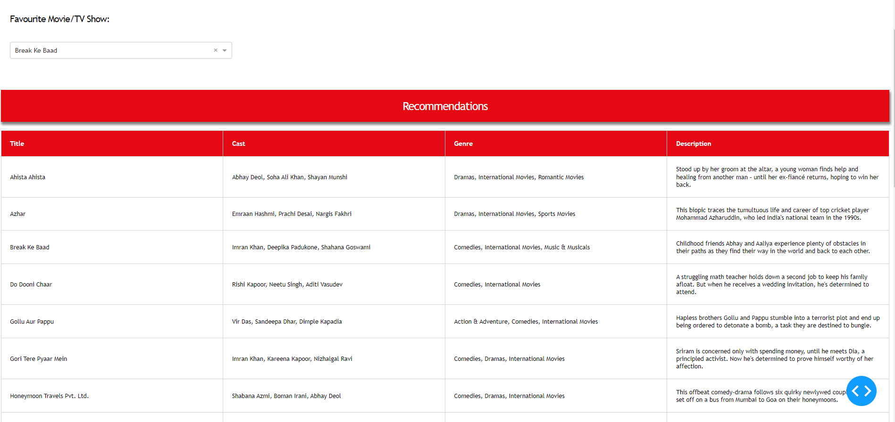
Dash Application

Slide 21
Conclusion
LDA and LSA has sorted much more similar titles in a group of genre
Recommendation system works perfectly well with description column
After applying K - means optimal value of number of clusters is 5
Silhouette score for a set of sample data points is used to measure how dense and well-separated the clusters are.

Slide 22
Q & A

